Slide 1
Parking System
team(Allopathy)

Slide 2
Why Parking system Required
Parking has become a critical problem in cities and urban areas, with limited space and a growing number of vehicles.
Parking management systems are essential to effectively manage parking spaces, reduce congestion, and increase revenue

Slide 3
Overview
In this project, we see the user which is owner or operator
We show different locations their different owner and operator
We show different parking locations their different rate
We show two types of customer one is customer and the rest are the daily customer which doesn’t have any type of parking pass
We show monthly pass, weekly pass and daily pass as per customer requirement.
We show billing to customers as per their use.

Slide 4
What are we build
We are building a parking system API
It will have the following feature:
Different location have their different owner & operator
Customer see the vehicle capacity as per the location
Different location have a different rate
Customer take monthly pass, weekly pass & daily pass
Customer can see their billing

Slide 5
Model
Following are models of parking system:
User:-The Users model is used to store information about the owner who supervises the parking system & operator who operates it.
Locations:-The Locations model is used to store information about the parking facilities, including location details, number of parking spaces, and real-time occupancy data. This model can be used to manage parking availability, pricing, and promotions. The Locations model can also be used to optimize parking space utilization and reduce traffic congestion.

Slide 6
Rates:-The Rates model is used to store information about the parking fees and rates for each parking facility. This model can be used to manage pricing policies, discounts, and promotions. The Rates model can also be used to generate revenue reports and optimize pricing strategies based on occupancy data.
Subscription:-The Subscription model is used to store information about the customers who have subscribed to the parking system. This model can be used to manage subscription plans, billing, and renewals. The Subscription model can also be used to provide personalized offers and promotions to subscribers, as well as to generate revenue reports based on subscription revenue.
Billings:-The Billing model is used to store information about the payments made by customers for parking fees, subscriptions, and other services. This model can be used to manage payment processing, refunds, and disputes. The Billing model can also be used to generate revenue reports and track the payment history for each customer

Slide 7
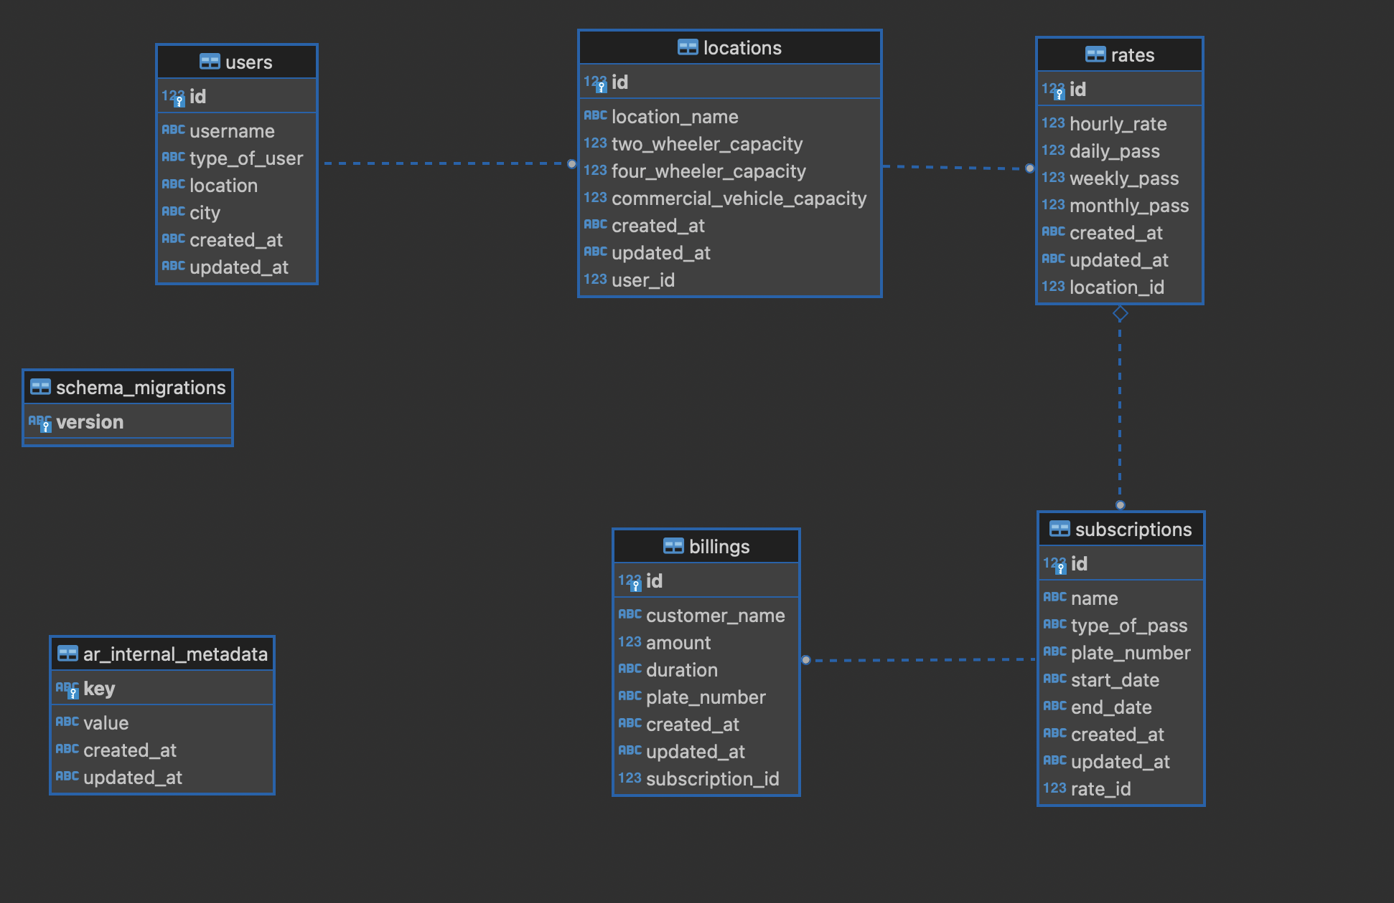
ER Diagram

Slide 8
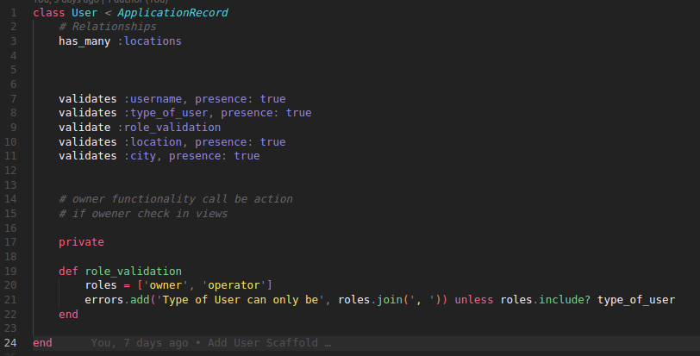
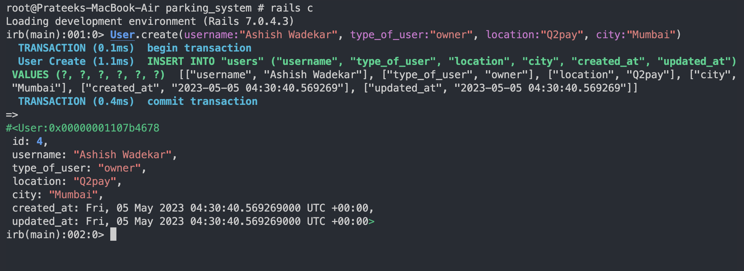
User

Slide 9
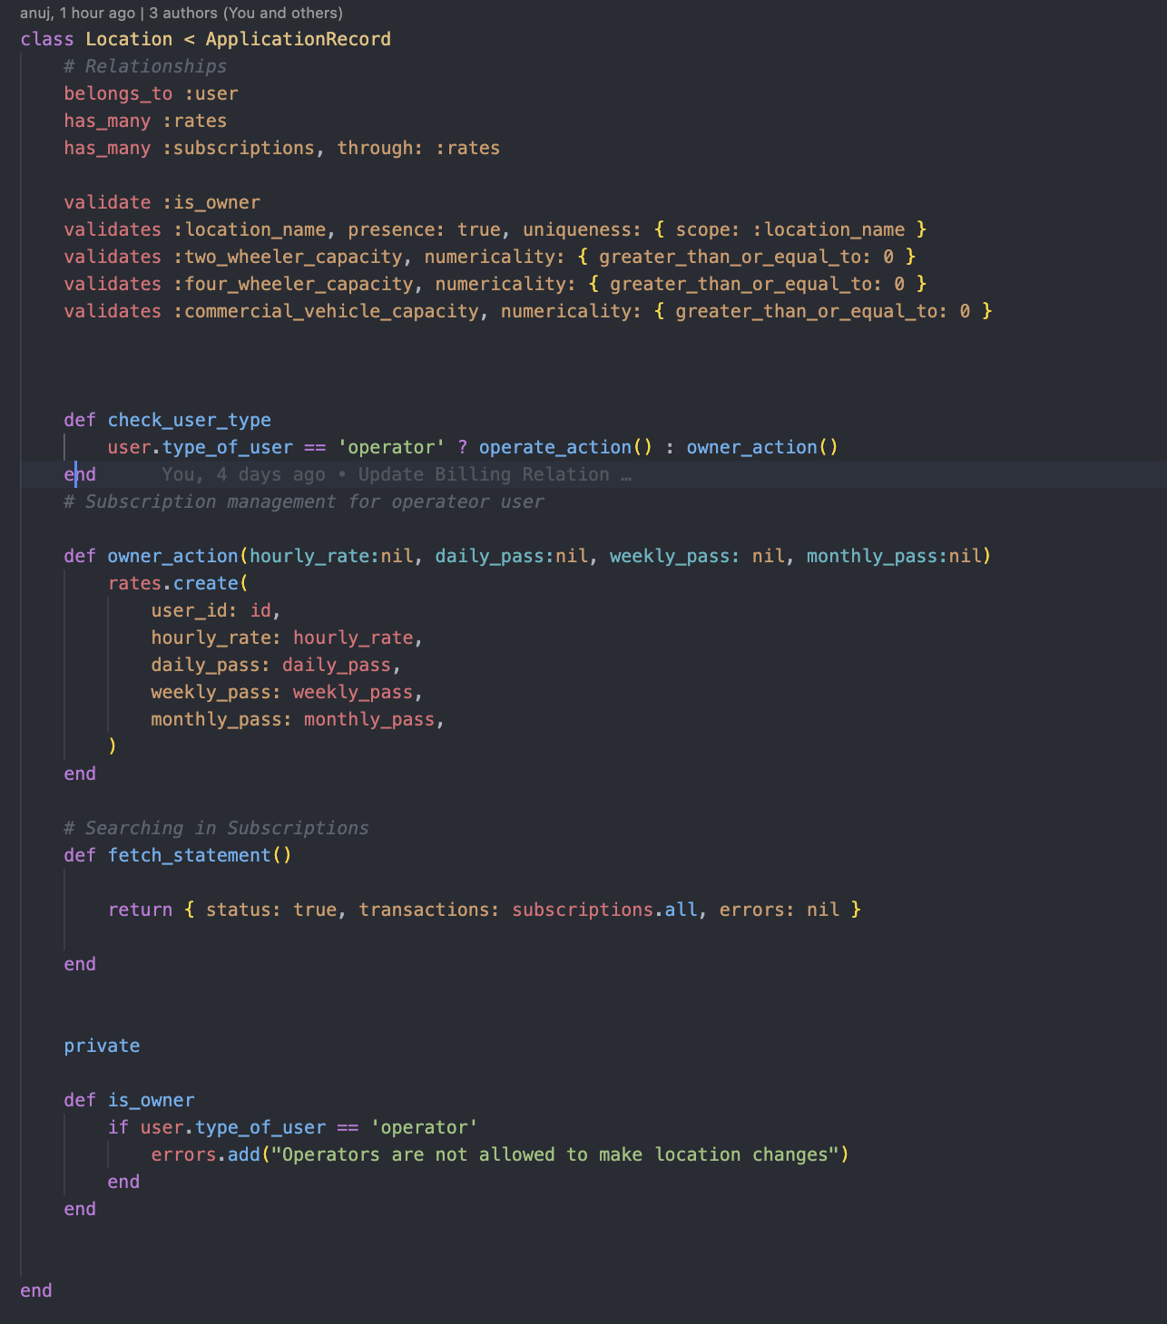
Location

Slide 10
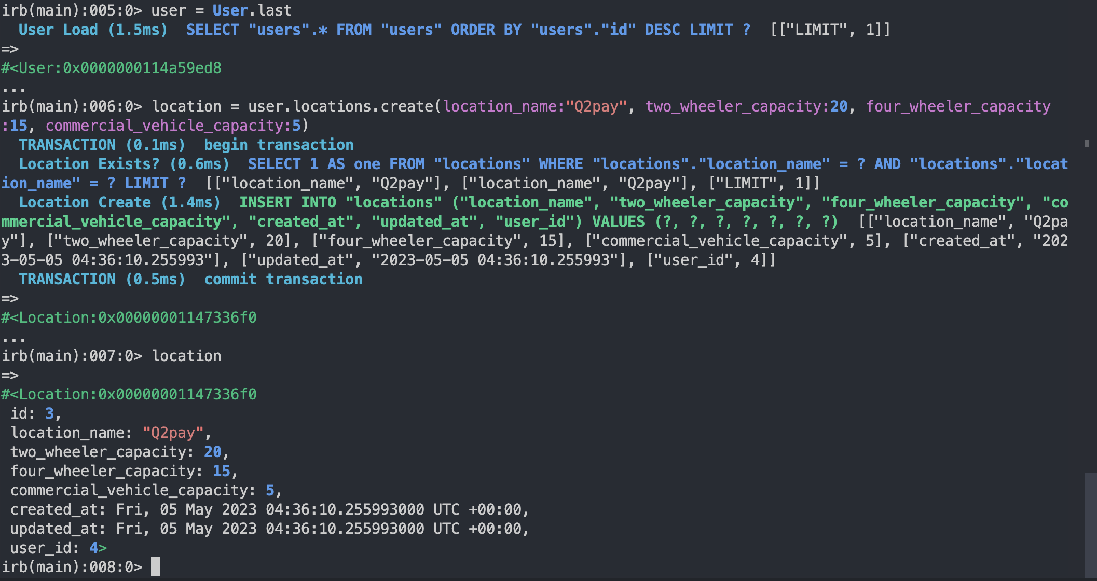

Slide 11
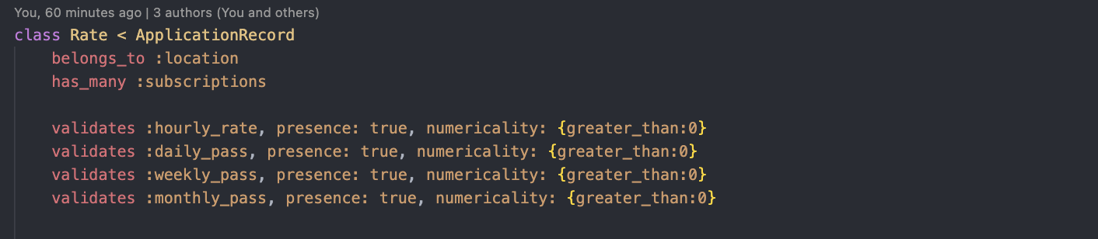
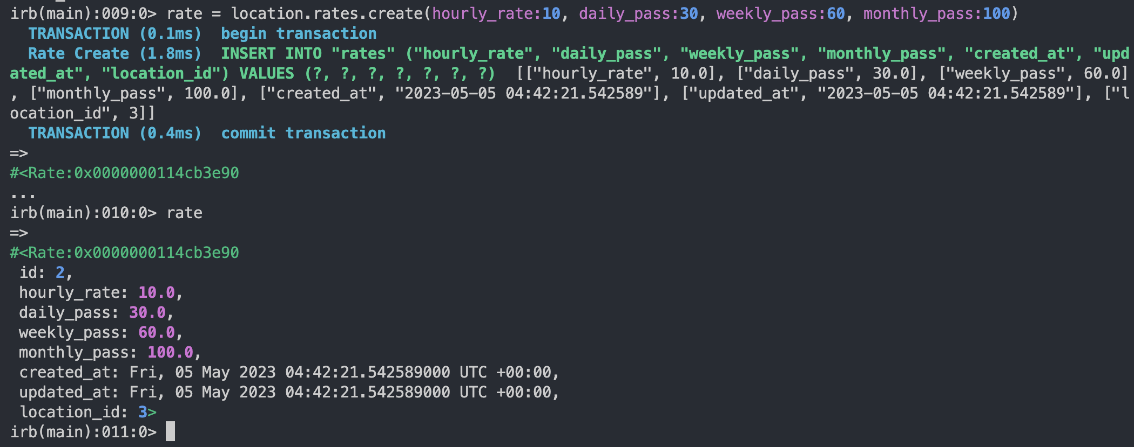
Rate

Slide 12
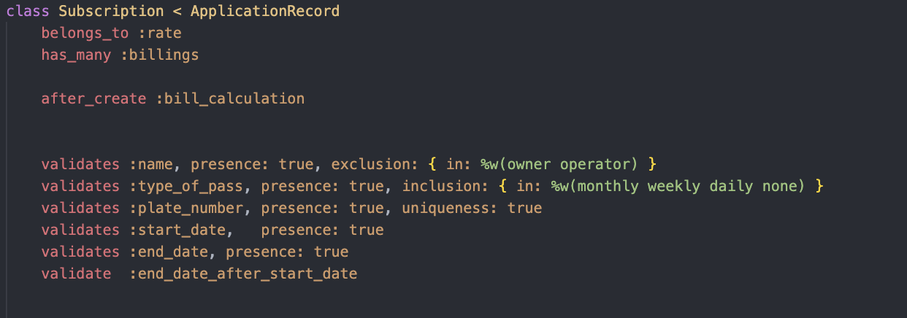
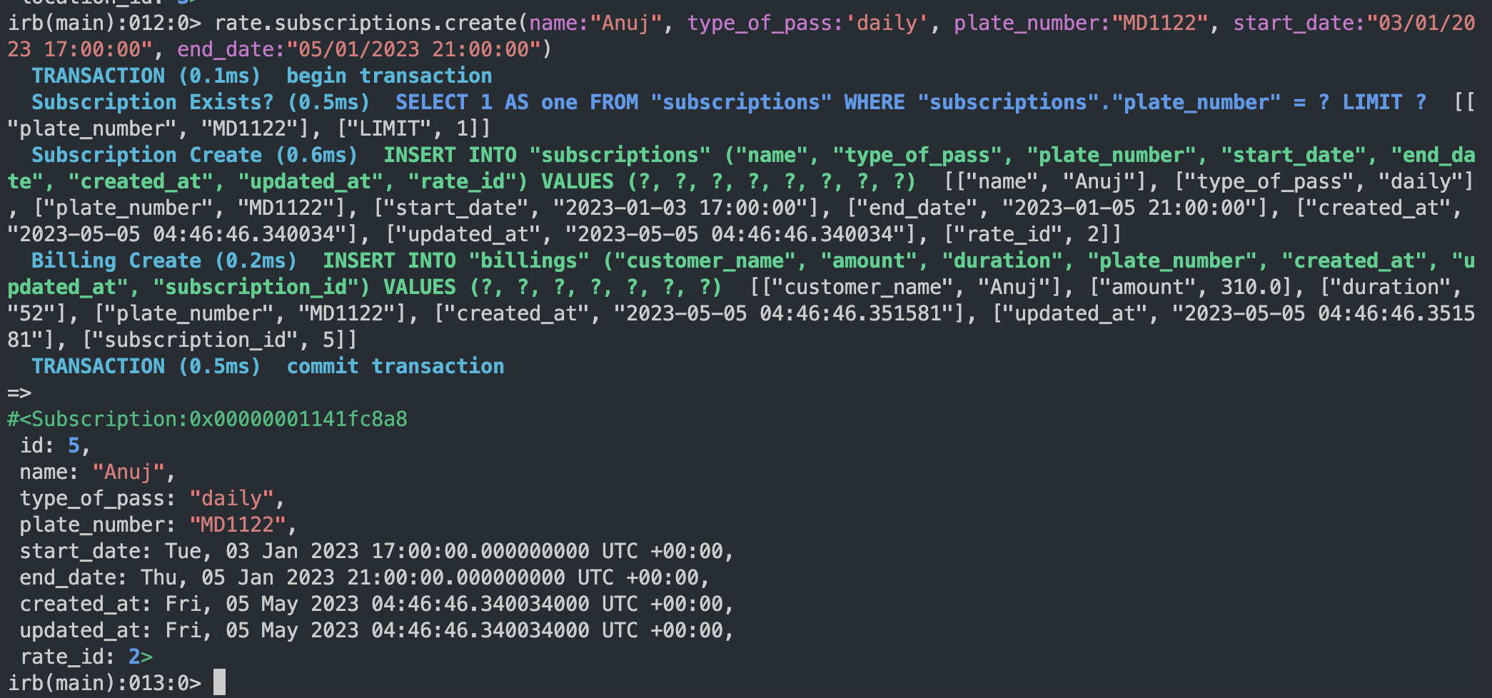
Subscription

Slide 13
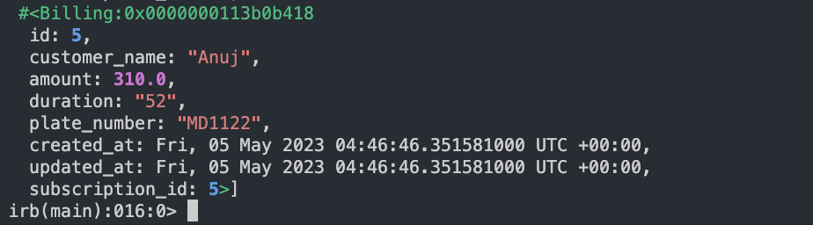
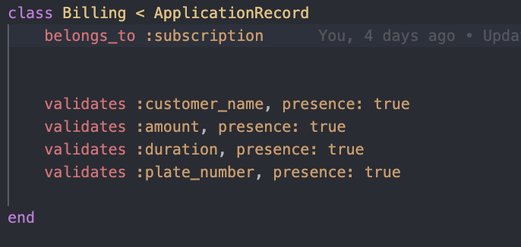
Billing

Slide 14
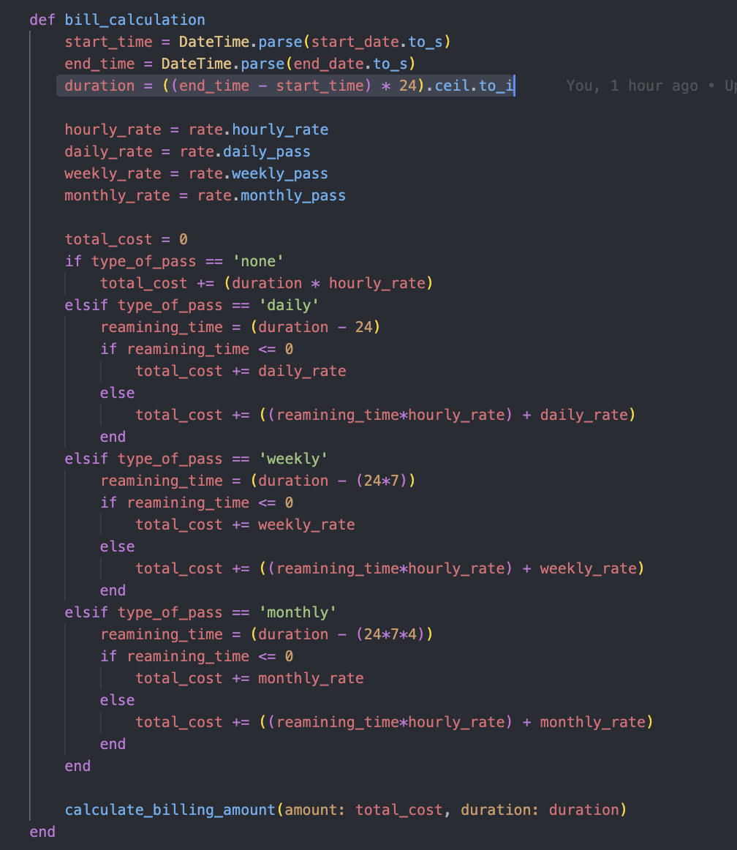
billing method

Slide 15
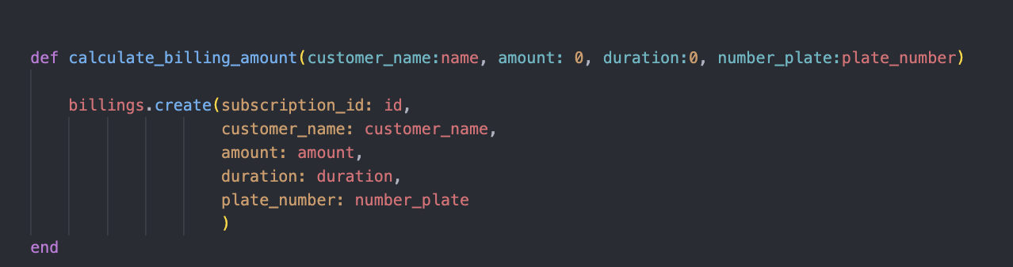
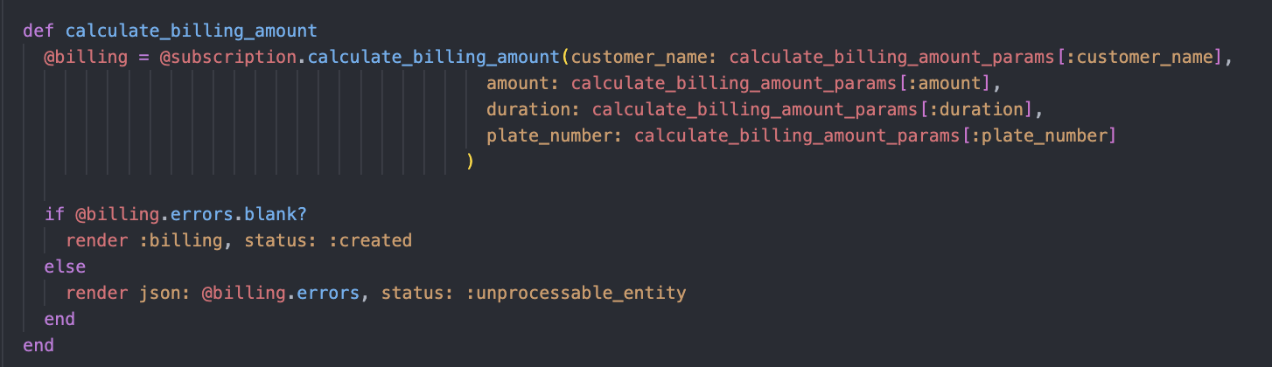
calculate_billing_amount
controller

Slide 16
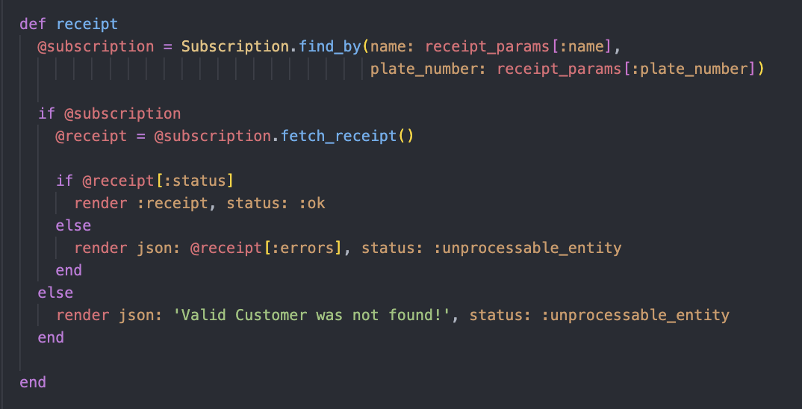
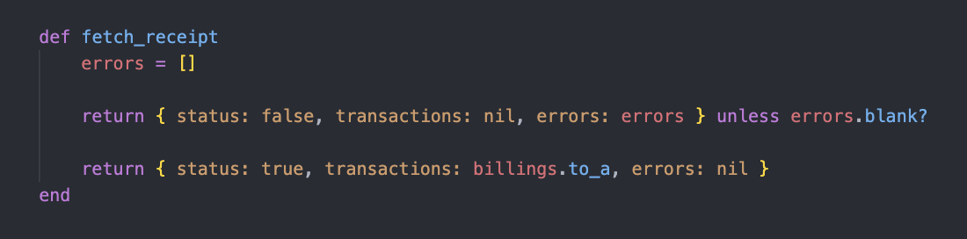
Receipt
subscription_controller
subscription_model

Slide 17
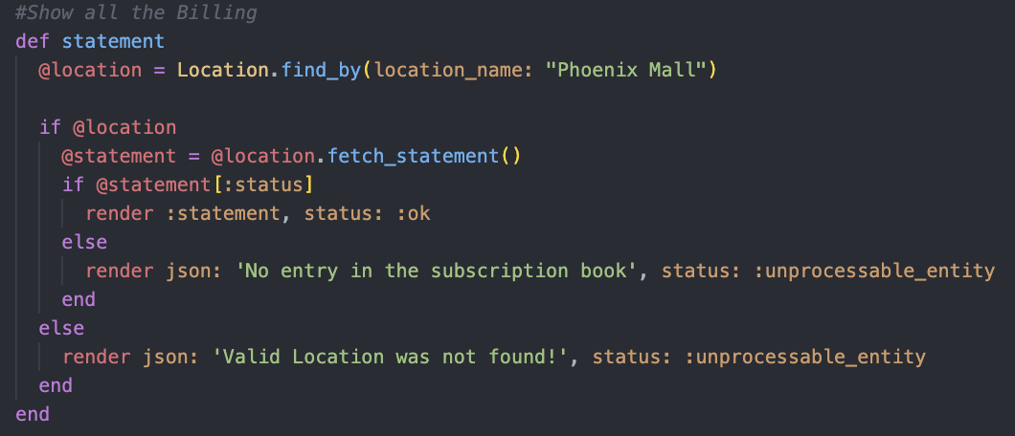
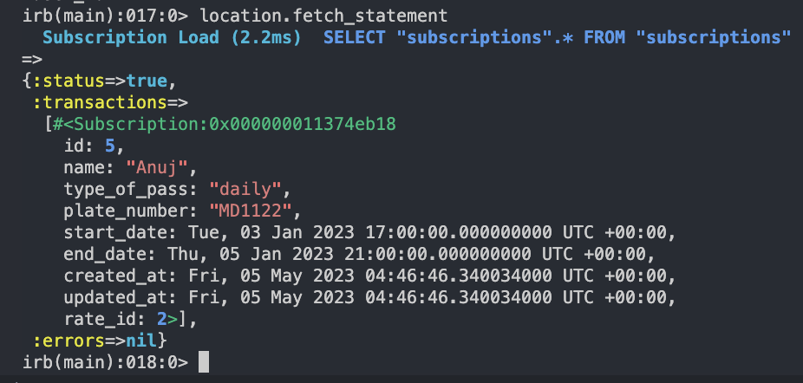
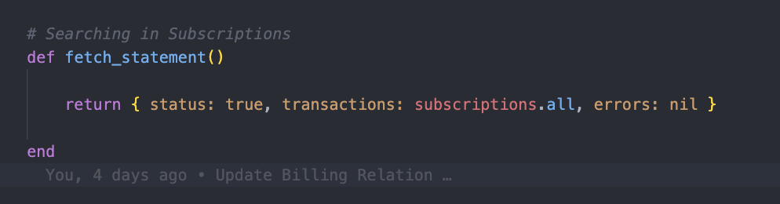
Statement
location_controller

Slide 18
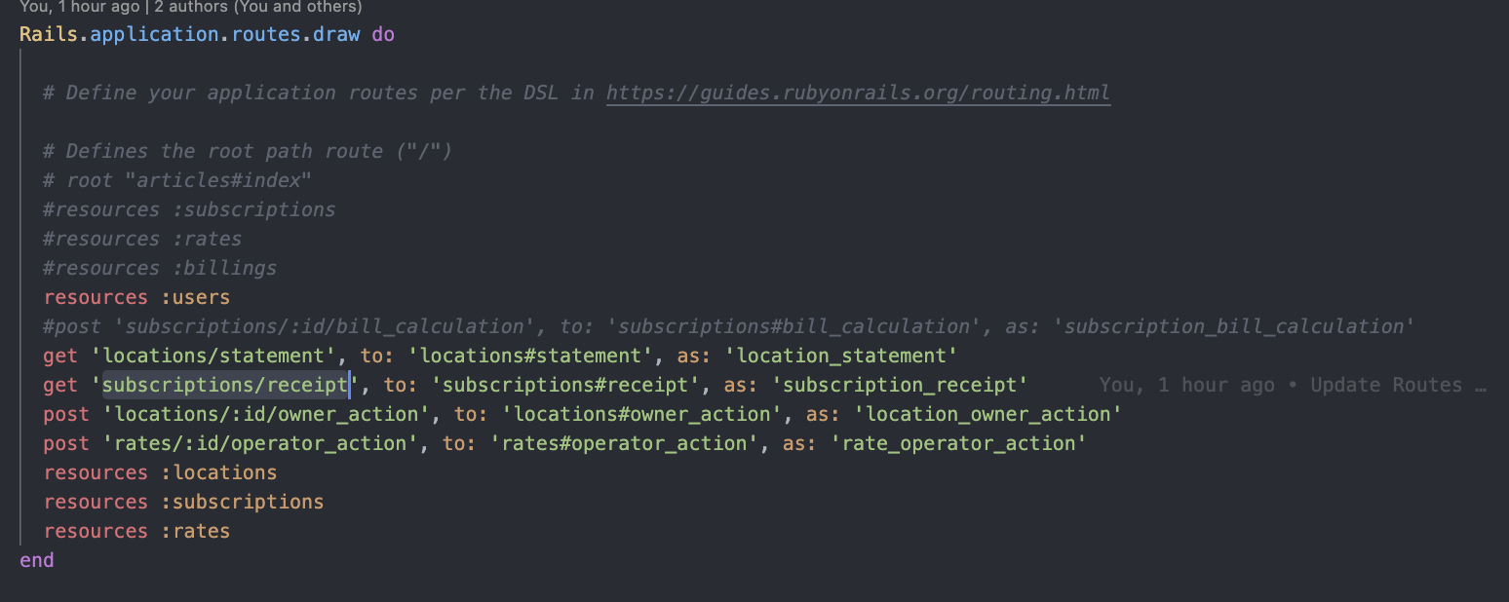
Routes

Slide 19
Challenges

Slide 20
Demo Of the project

Slide 21
Thank You
Team Members::-
Anuj
Prajakta
Prateek

